Slide 1



Vertical Slice Architecture
Jimmy Bogard
@jbogard
github.com/jbogard
jimmybogard.com

Slide 2

History Lesson

Slide 3
Traditional n-tier
UI Layer
Business Logic Layer
Data Access Layer
Database

Slide 4
Organizing by layer
Person.cs
PersonController.cs
PersonService.cs
PersonRepository.cs

Slide 5
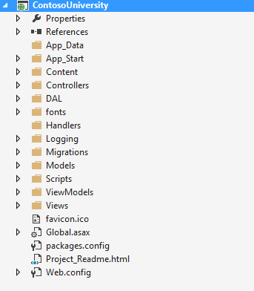
Areas of change

Slide 6
Vertical Slice Architecture Model and organize application architecture around axes of change, vertical slices

Slide 7
Vertical Slices

Slide 8
Move code to single place

Slide 9
Move service methods to classes
Invoice Service
void Approve()
ApproveInvoice {}
void Reject()
RejectInvoice {}
void Flag()
FlagInvoice {}

Slide 10
Modeling requests
Input
Request Handler
Output

Slide 11
Request/Response with MediatR
IRequest<T>
IRequest
Handler<T>
T
Task<T> Handle(
IRequest request) {
}

Slide 12
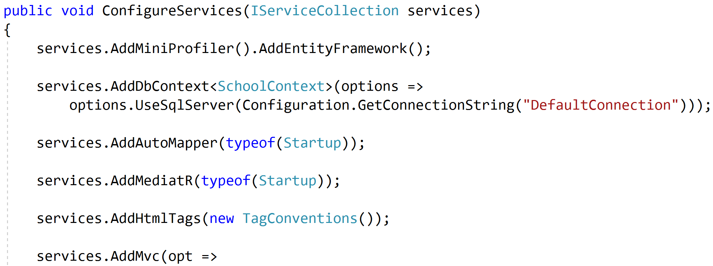
Registering MediatR

Slide 13
Commands and Queries
Web App
GET
Query
Handler
Response
Query
POST
Command
Handler
Response
Command

Slide 14
One model in, one model out
Query
Handler
Response
Command
Handler
Response

Slide 15
Complete encapsulation
Request
Response

Slide 16
Modeling Queries
Query
Handler
Response

Slide 17
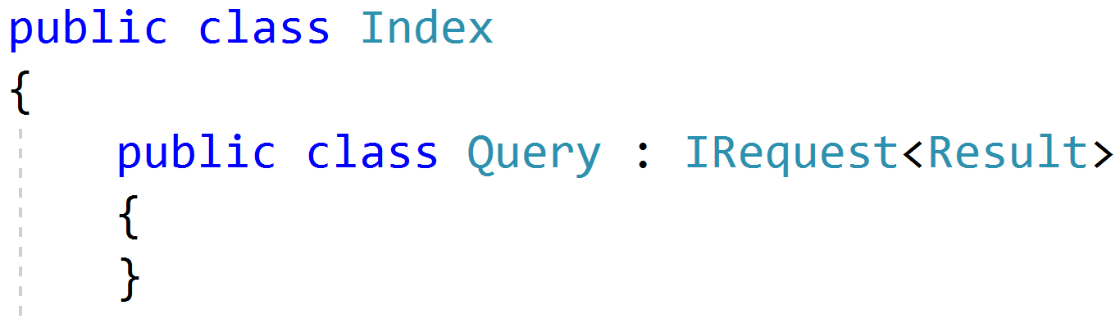
Simple Queries

Slide 18
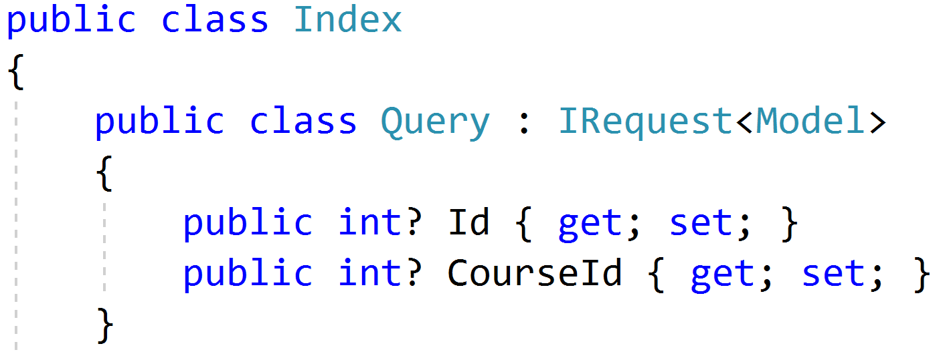
Parameterized Queries

Slide 19
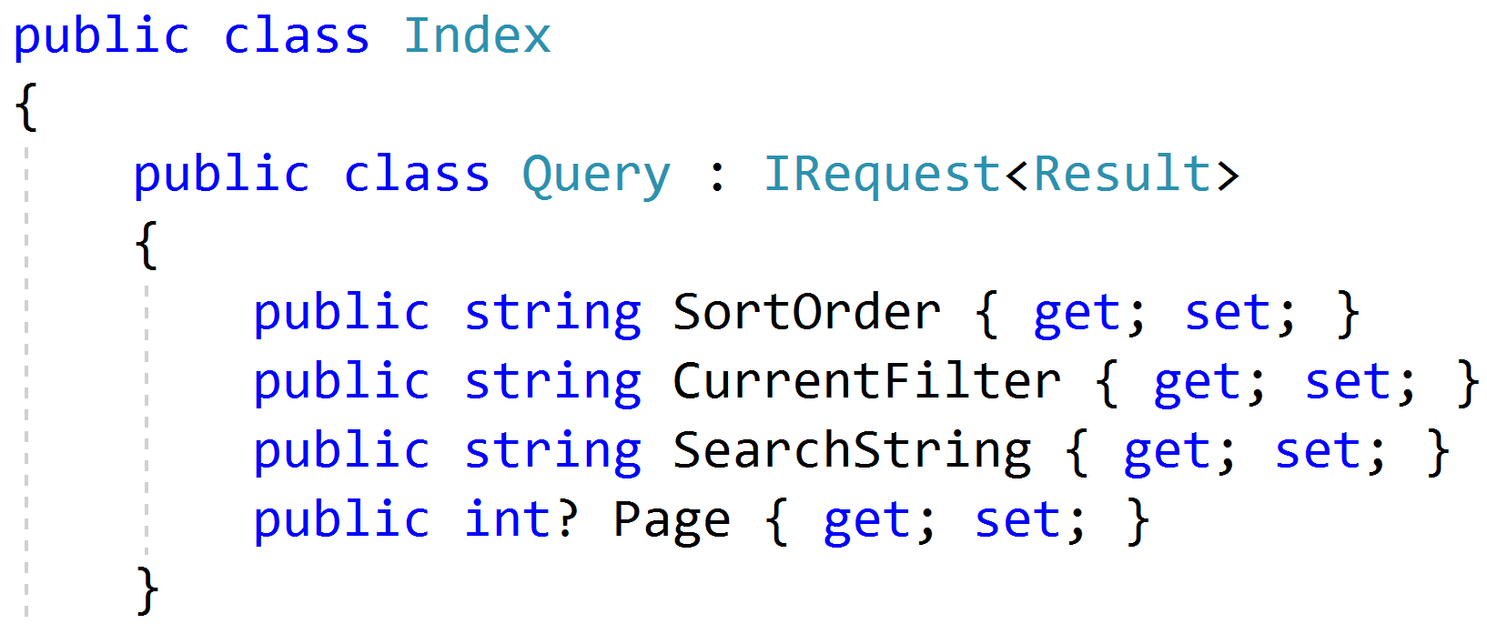
Paging/Sorting/Filtering

Slide 20
Modeling Responses
Query
Handler
Response
View

Slide 21
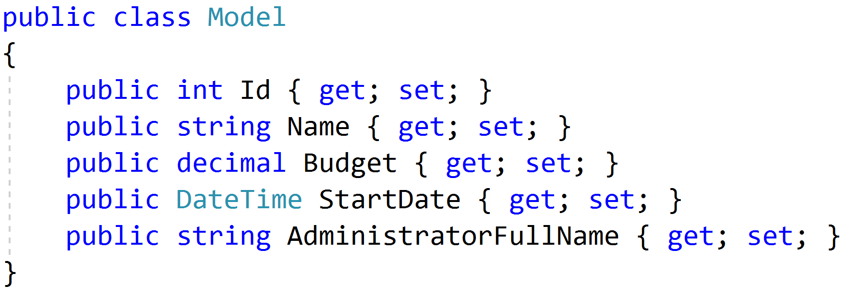
Simple Response

Slide 22
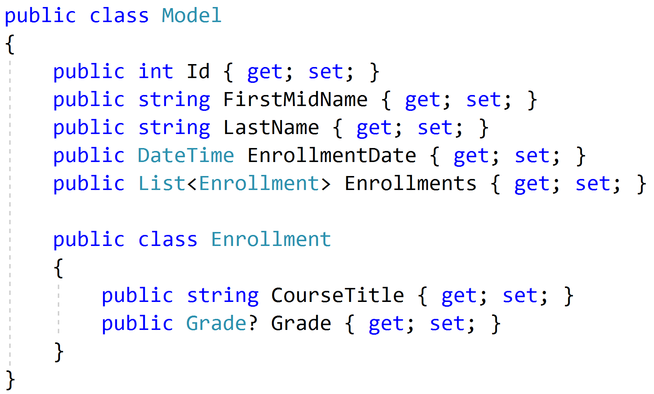
Complex Response

Slide 23
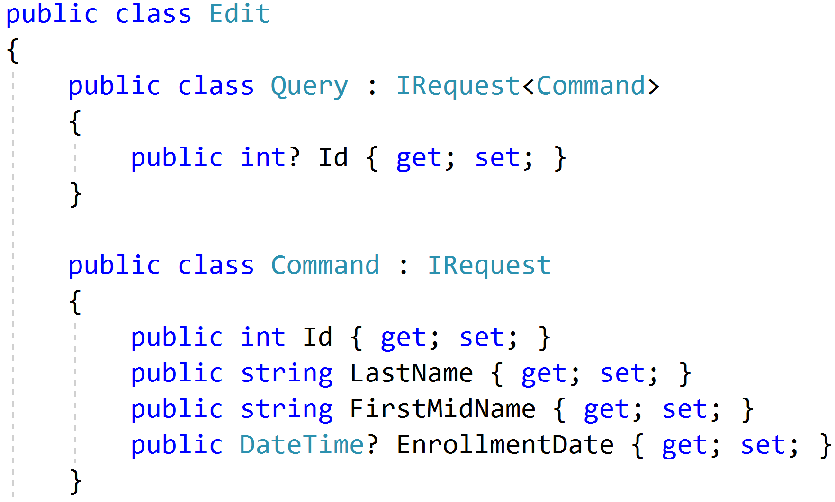
Command/Query Duality

Slide 24
Modeling Commands
Command
Handler
Response

Slide 25
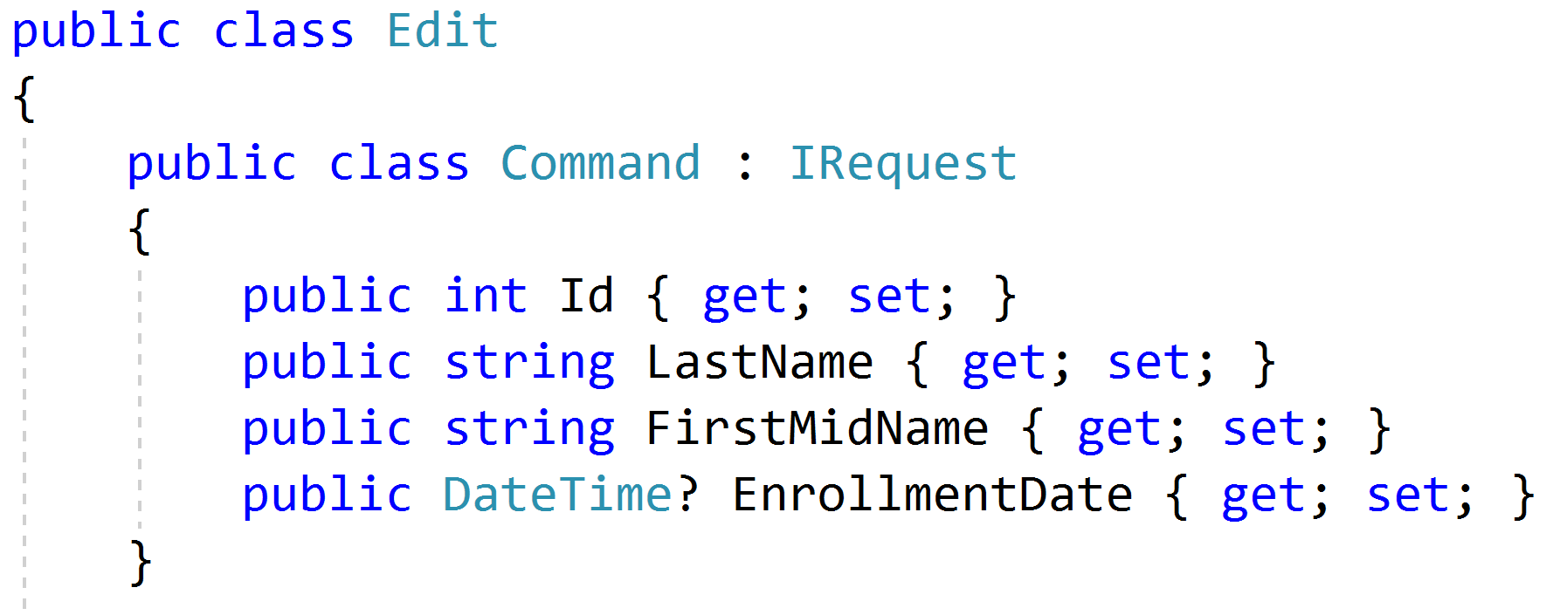
Simple Commands

Slide 26
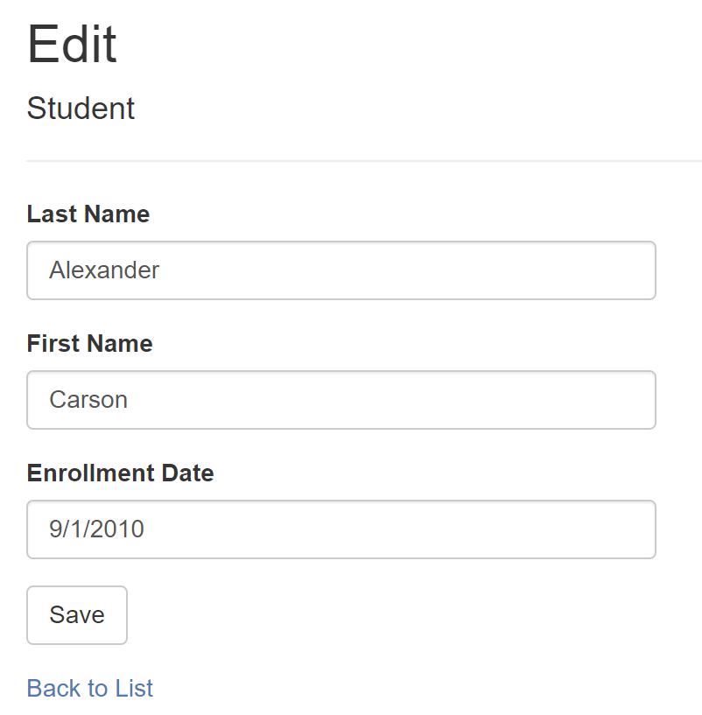
Model-Bound Types

Slide 27
Task-Based UIs
Transfer
Student Details
Request
Handler
Response
Transfer
Correct
Schedule
…
…
…
…
…
…
…
Correct
Request
Handler
Response
Schedule
Request
Handler
Response

Slide 28
Modeling Command Responses
Command
Handler
Response

Slide 29
Void Response
Command
Handler
IRequest

Slide 30
Command Result Response
Command
Handler
T
IRequest<T>

Slide 31
Success/Fail
Command
Handler
true/
false
IRequest<bool>

Slide 32
Creation
Create
Handler
Id
IRequest<Guid>
302 Found
/orders/081bcba7-89ff-4a41-af90-ded095160b99

Slide 33
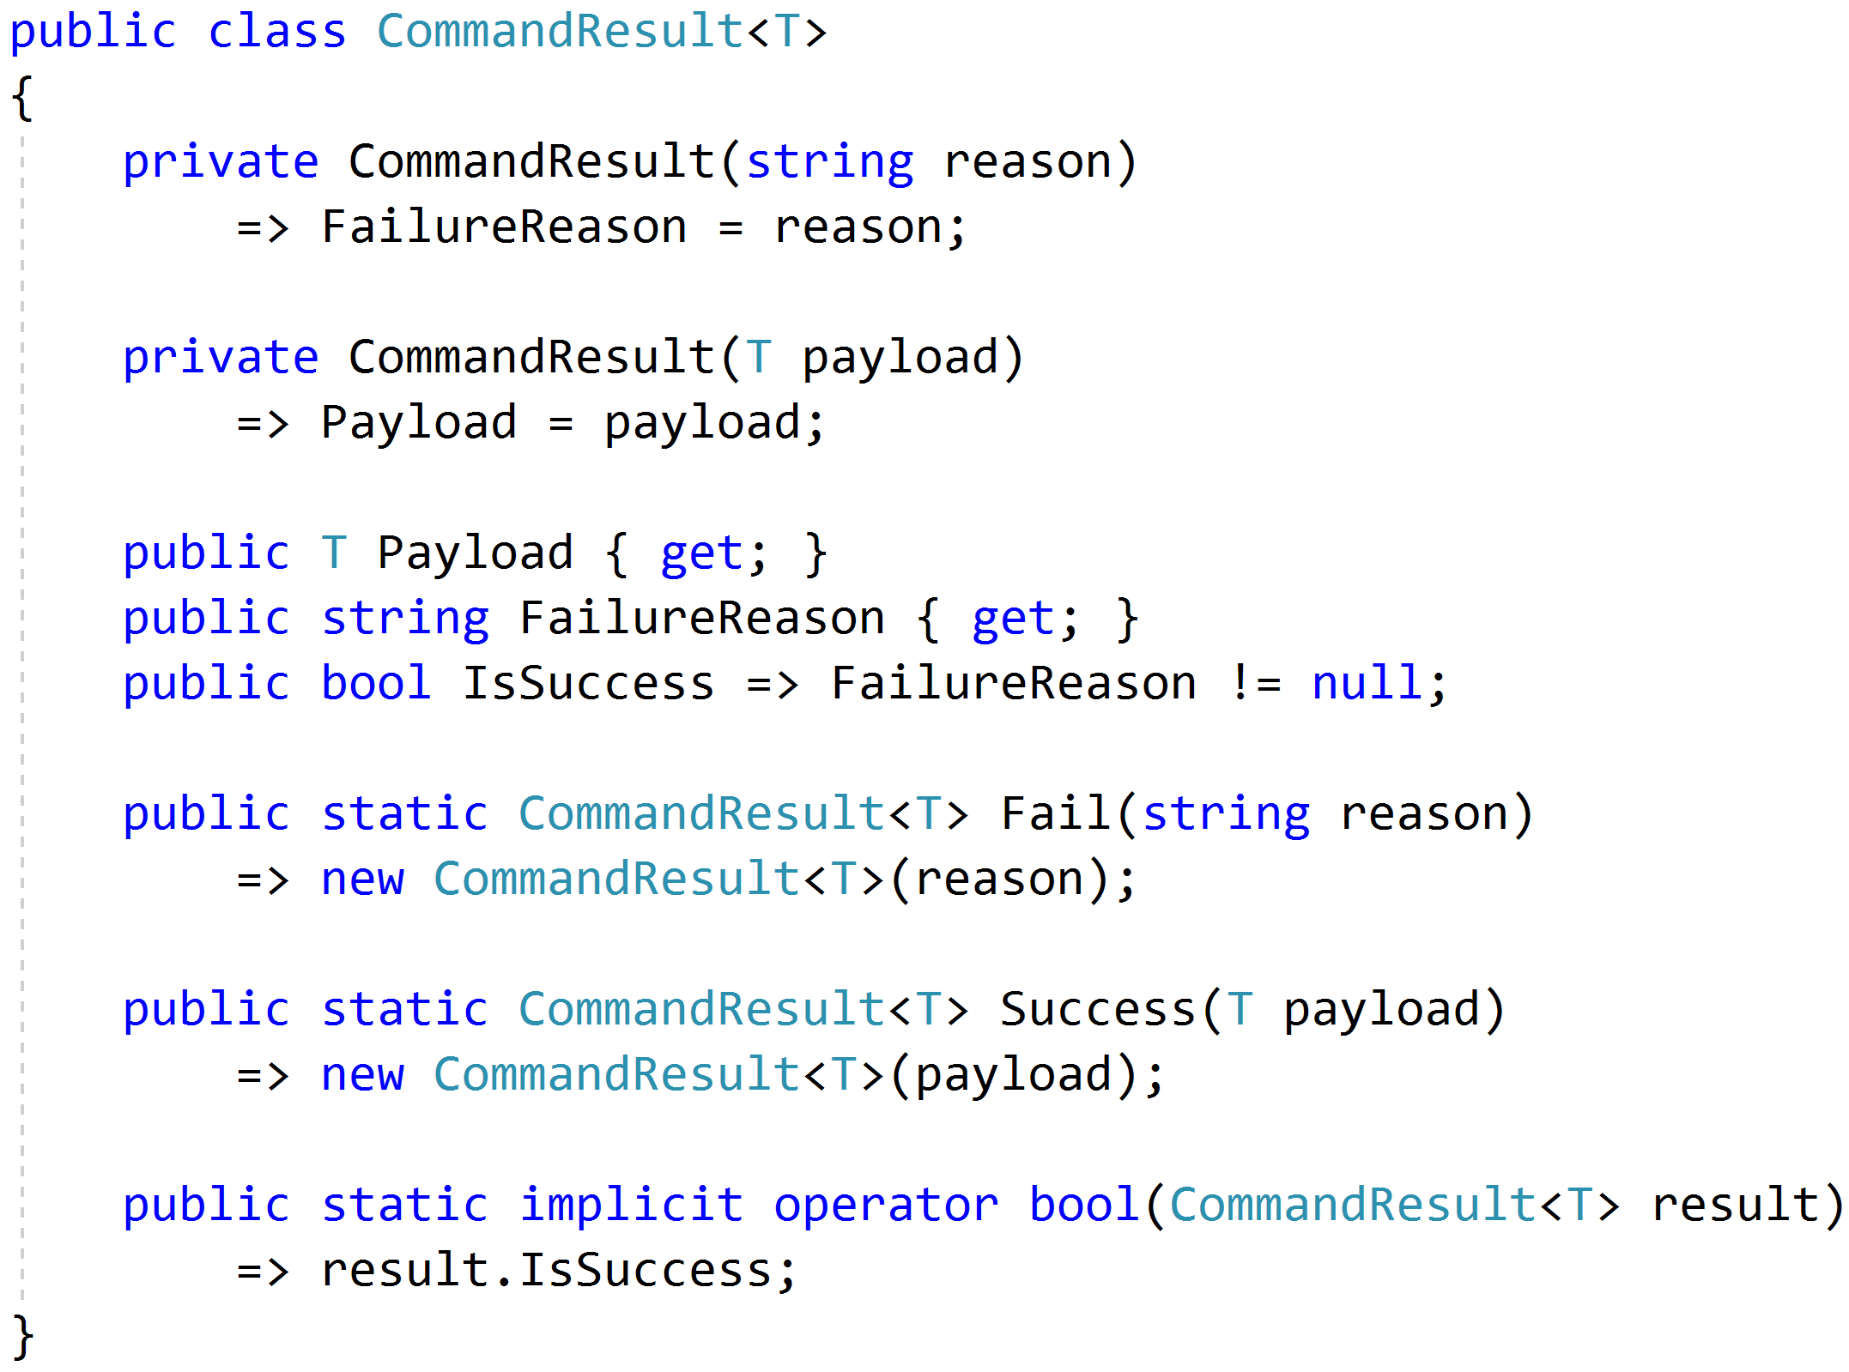
Complete Response

Slide 34
Modeling Query Handlers
Query
Handler
Response

Slide 35
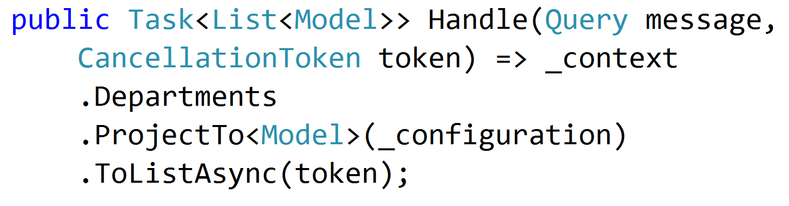
Simple AutoMapper Projections

Slide 36
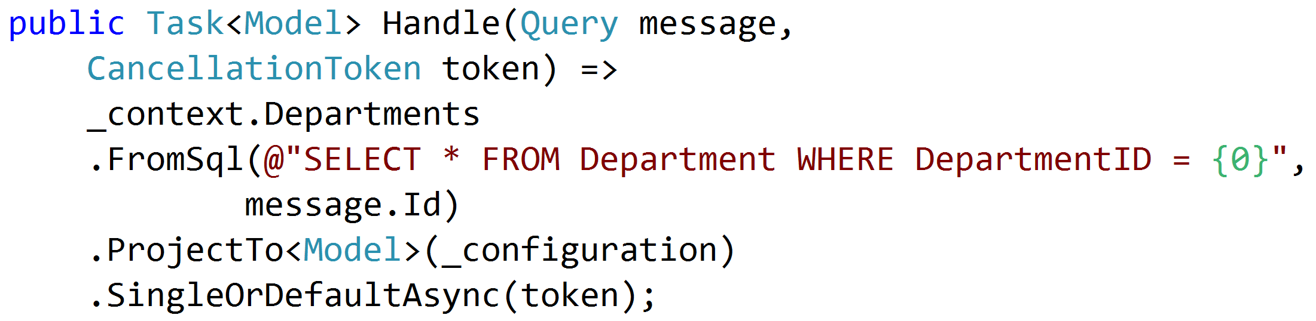
SQL Projections

Slide 37
Encapsulated Logic
Query
EF Core
Response
Query
Dapper
Response
Query
HttpClient
Response
Query
MeatGrinder
Response

Slide 38
Duplicate Logic
Query
Handler
Response
Common
Query
Handler
Response
Common

Slide 39
Refactor
Query
Handler
Response
Class?
Function?
Extension Method?
Common
Query
Handler
Response

Slide 40
Command Handlers
Command
Handler
Response

Slide 41
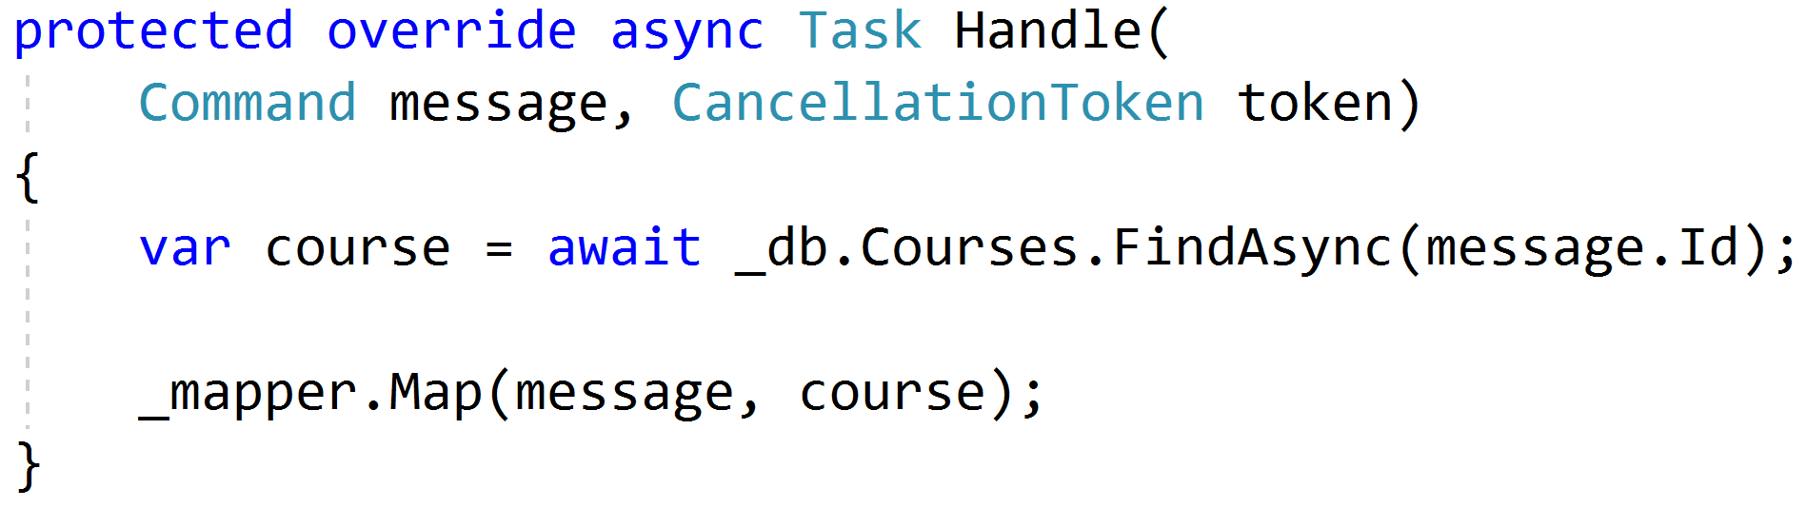
Procedural Beginnings

Slide 42
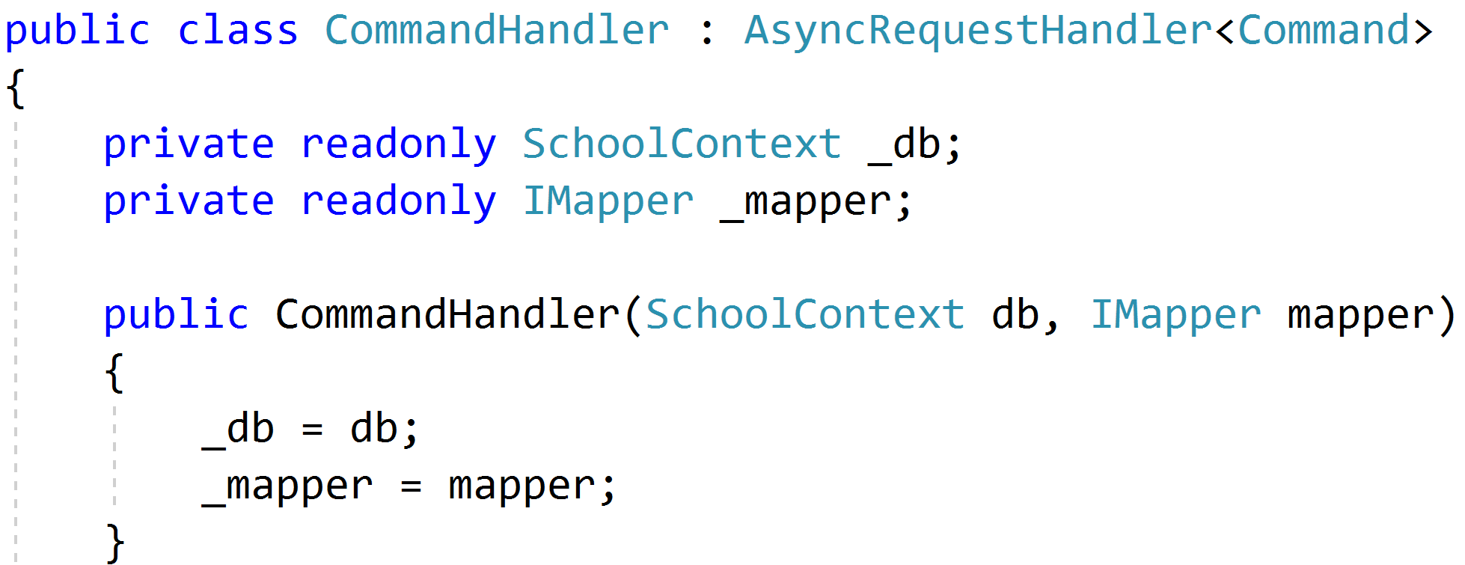
DI with no abstractions

Slide 43
Don't Panic!

Slide 44
Red
Green
Refactor

Slide 45

Code Smells
Large Class
Extract Class
Extract Subclass
Extract Interface
Extract Method
Replace Method
with Method Object
Compose Method
Long Method

Slide 46

Behavioral Smells
Combinatorial Explosion
Conditional Complexity
Feature Envy
Inappropriate Intimacy
Duplicated Code

Slide 47
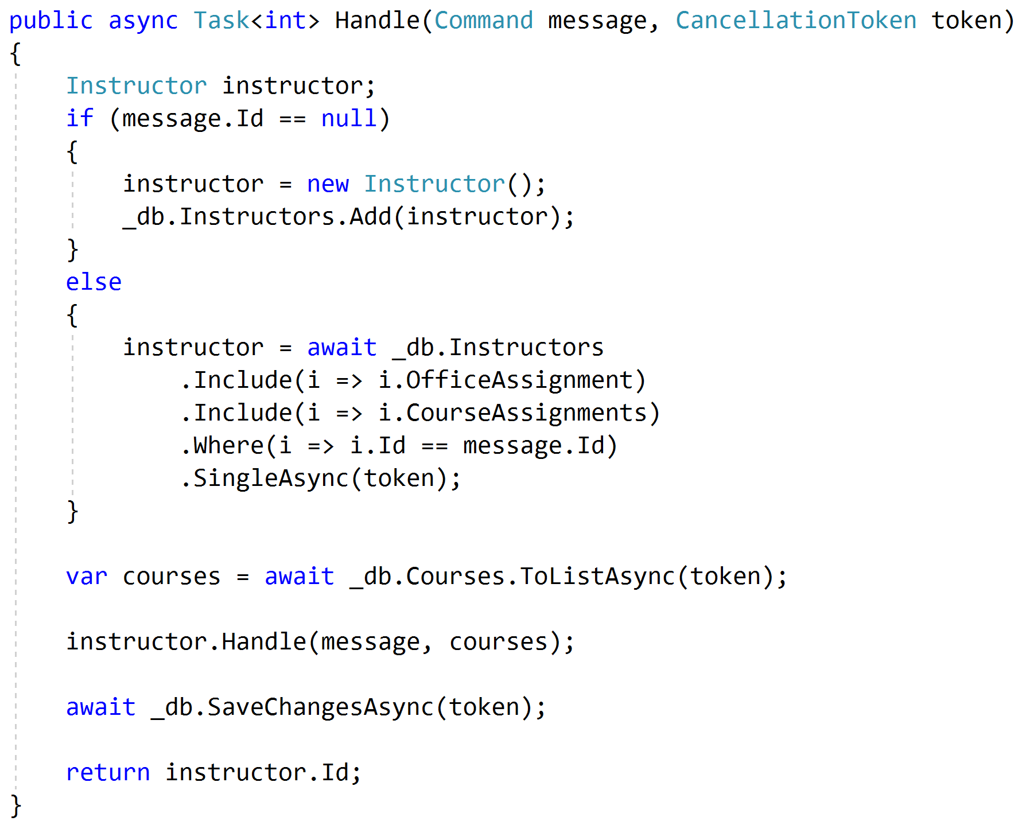
Push Behavior Down
Request
Handler
Domain
Response

Slide 48
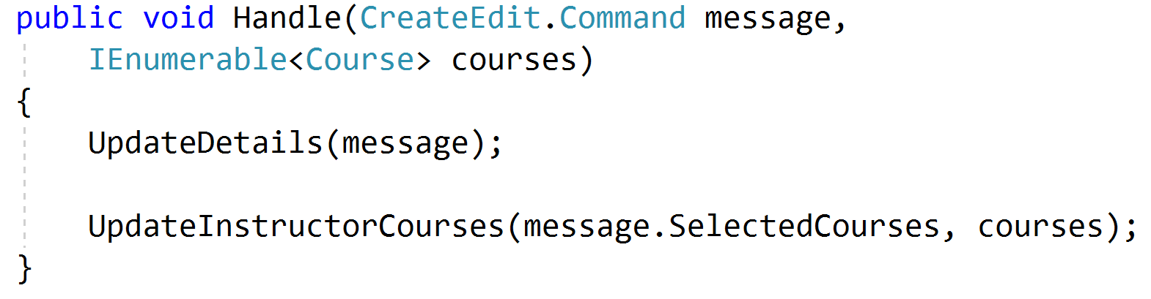
Encapsulated Domain
Request
Handler
Domain
Response

Slide 49
Validation Scopes
Command Validation
Domain Model
Request Validation
Request
Database
External Models

Slide 50
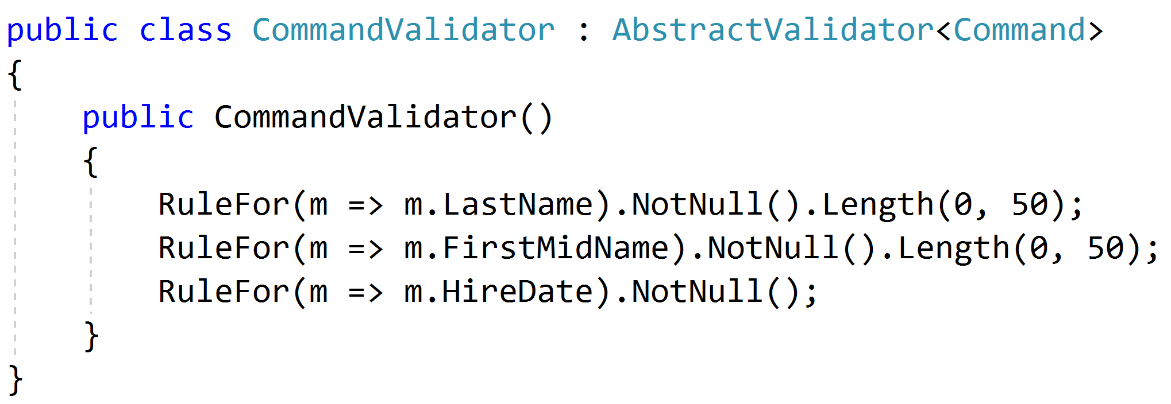
Request Validation

Slide 51
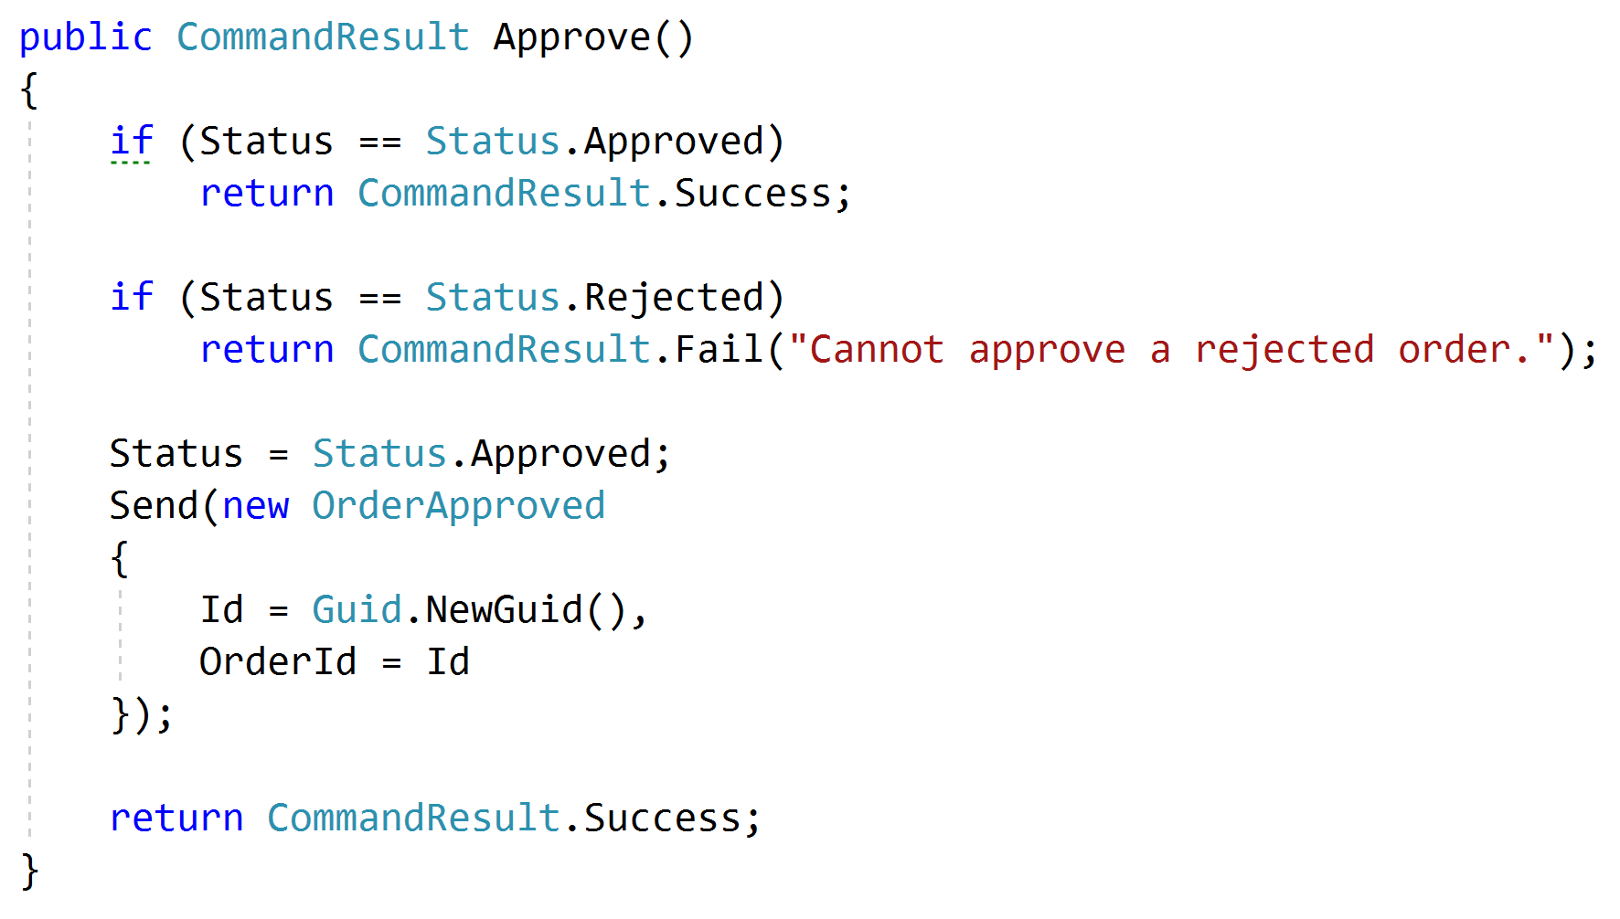
Domain Validation
Request
Handler
Domain + Validation
Response

Slide 52
Representations
Query
Handler
Response
????

Slide 53
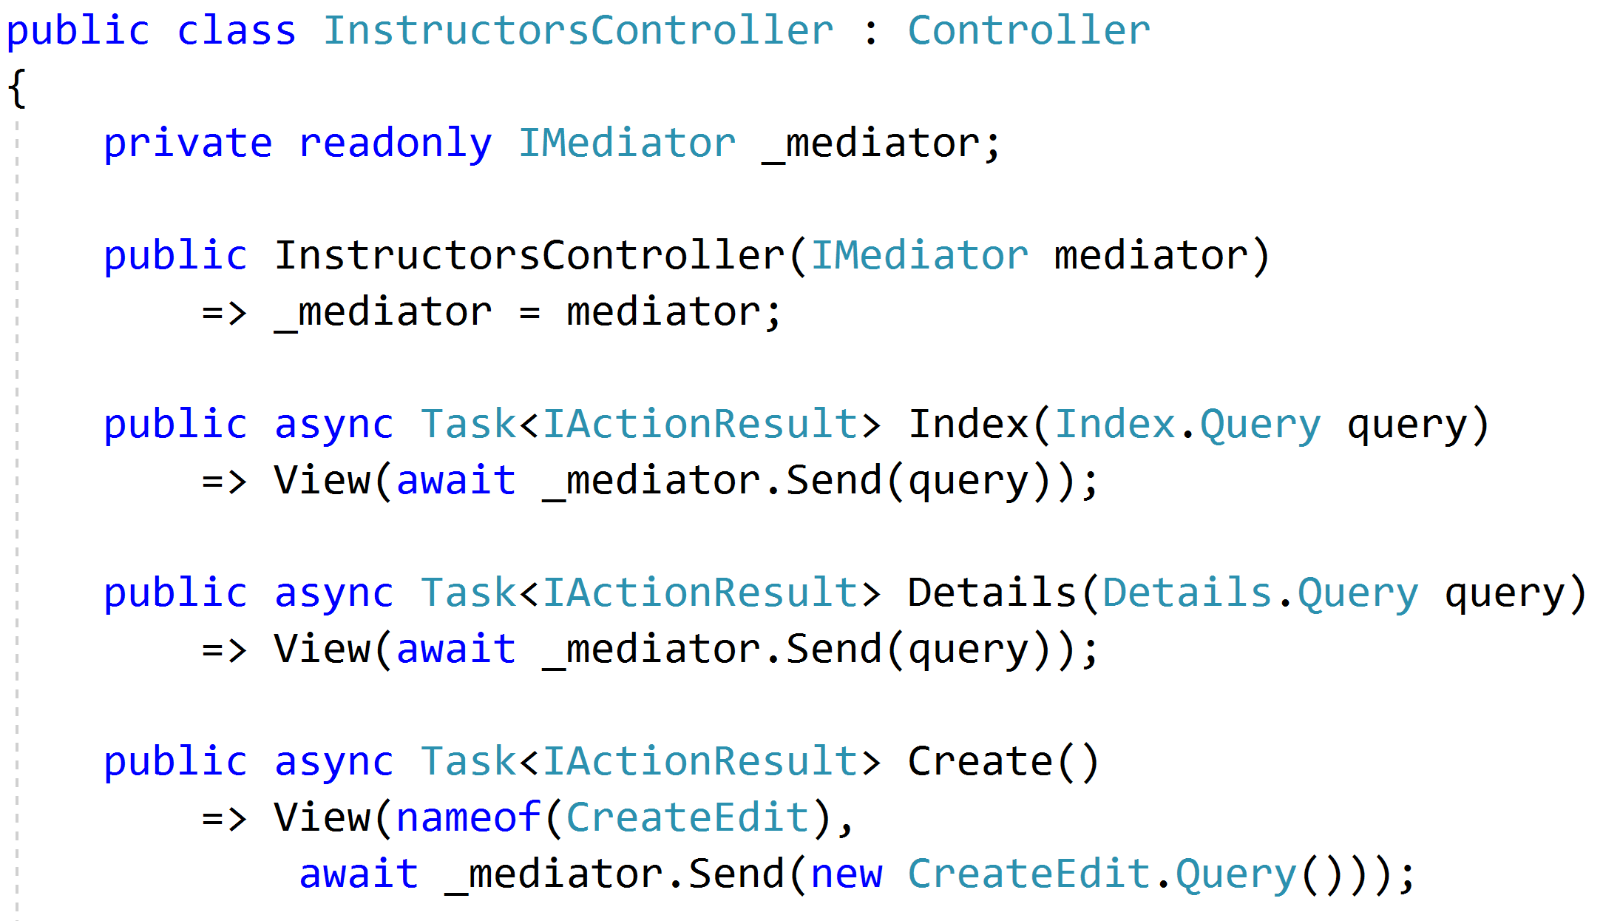
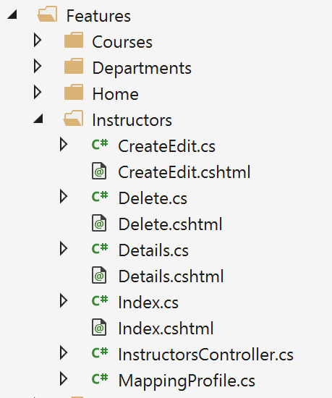
Controllers as routes

Slide 54
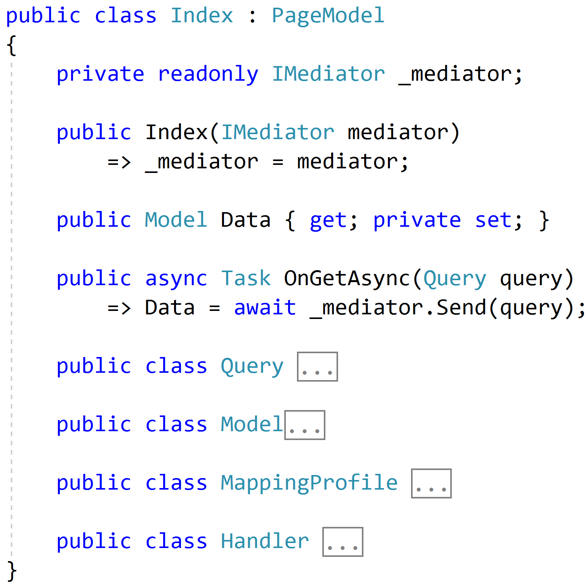
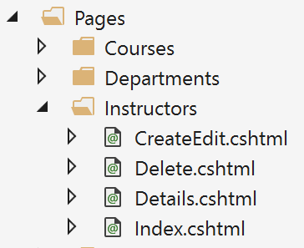
Razor Pages

Slide 55
Web APIs
/order/approve
Handler
/order/reject
Handler
Order json
/order/hold
Handler
/order/cancel
Handler
SPA

Slide 56
Cross-Cutting Concerns
Duplication
Request
Handler
Response

Slide 57
Pipeline Behavior (Decorator)
Pipeline Behavior
Request
Handler
Response

Slide 58
Stackable Decorators
Pipeline Behavior
Pipeline Behavior
Pipeline Behavior
Handler

Slide 59
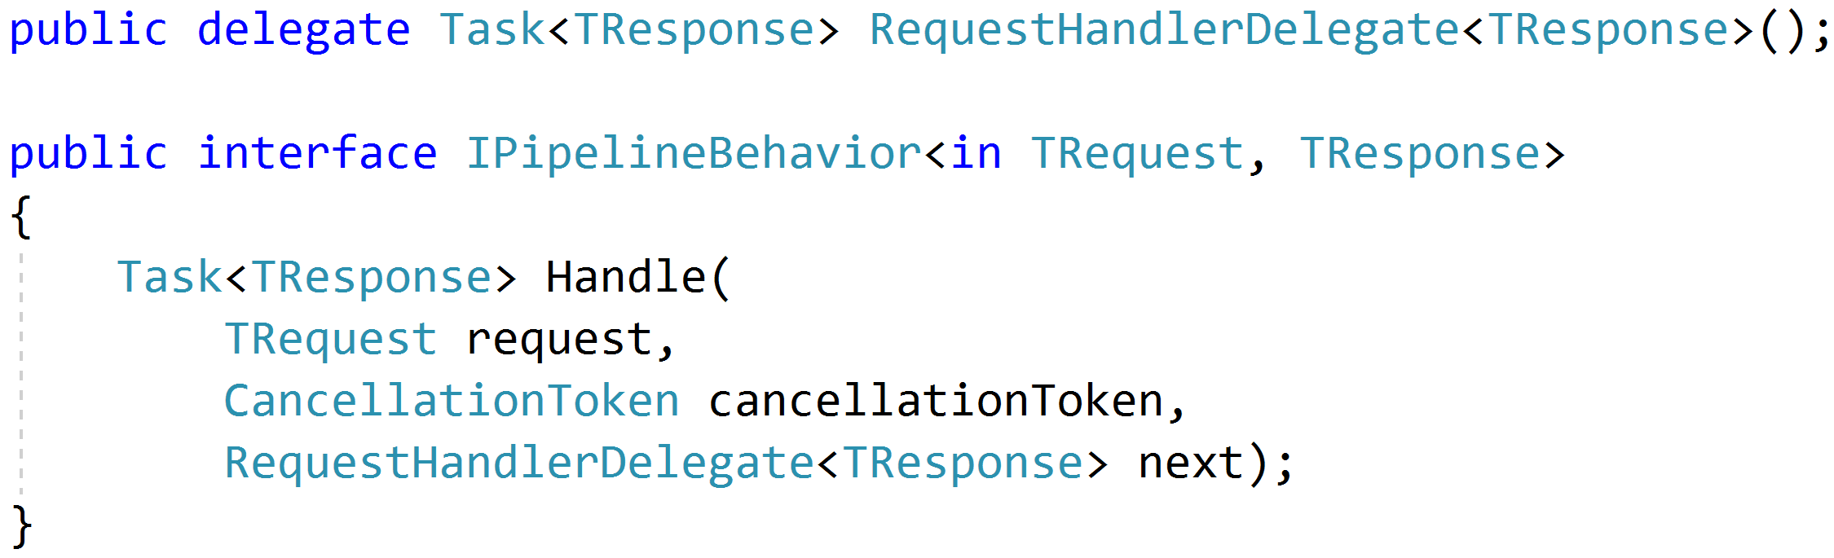
Think: Action Filters

Slide 60
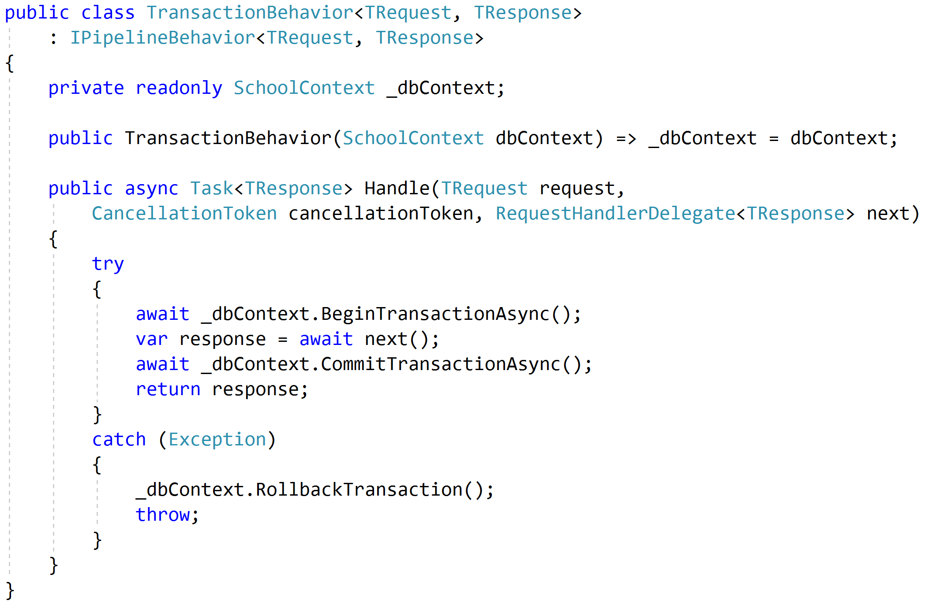
Transactions

Slide 61
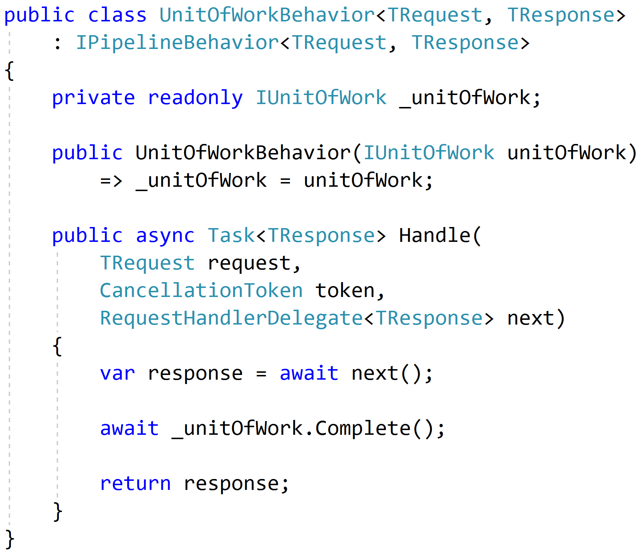
Unit of Work

Slide 62
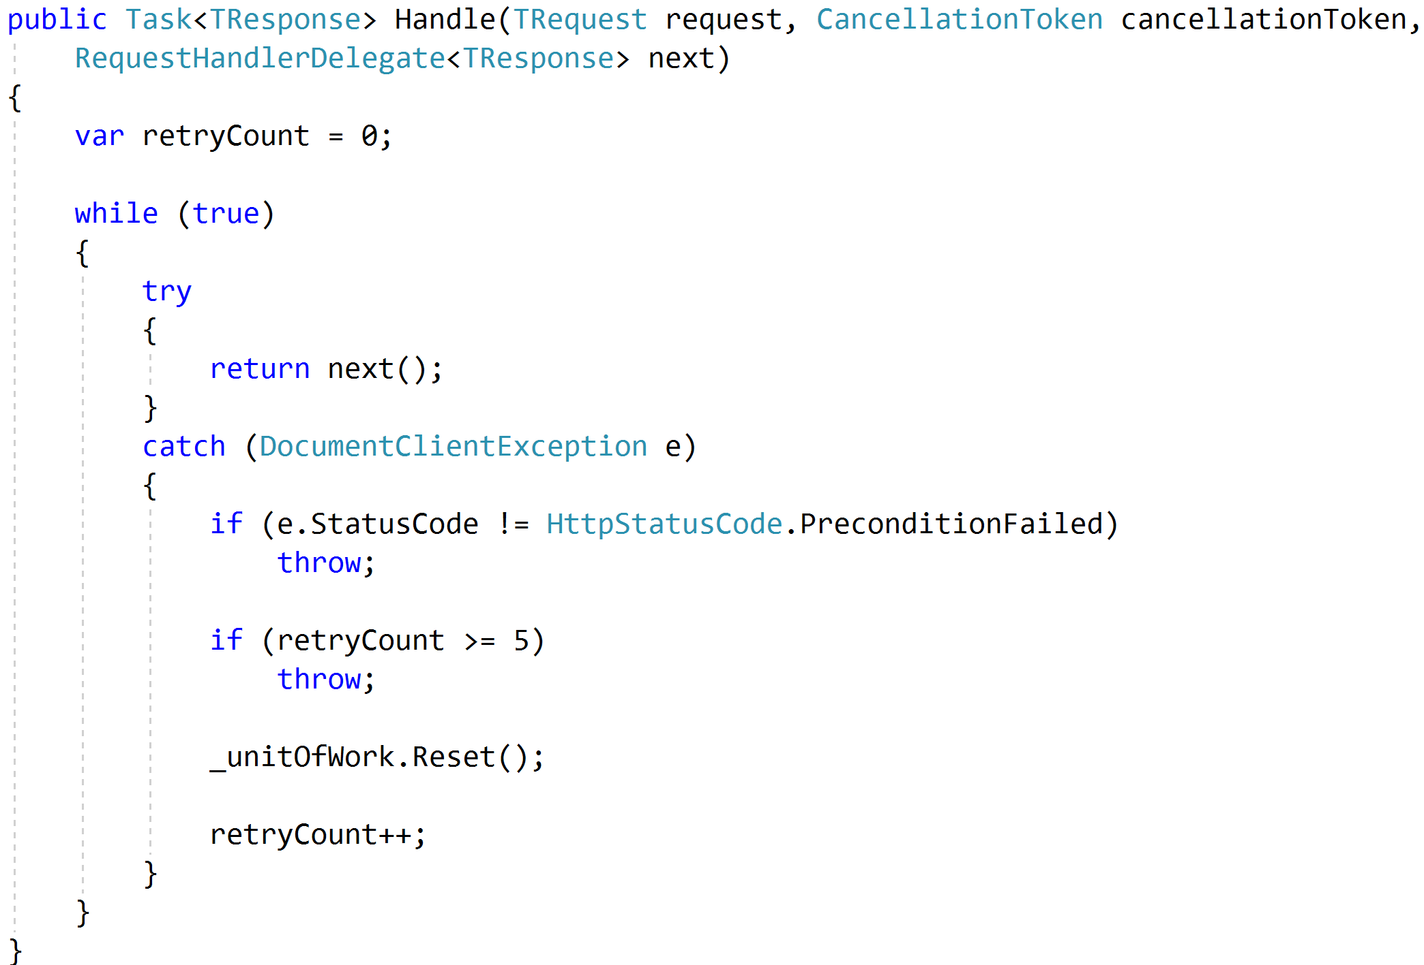
Concurrency and Retries

Slide 63
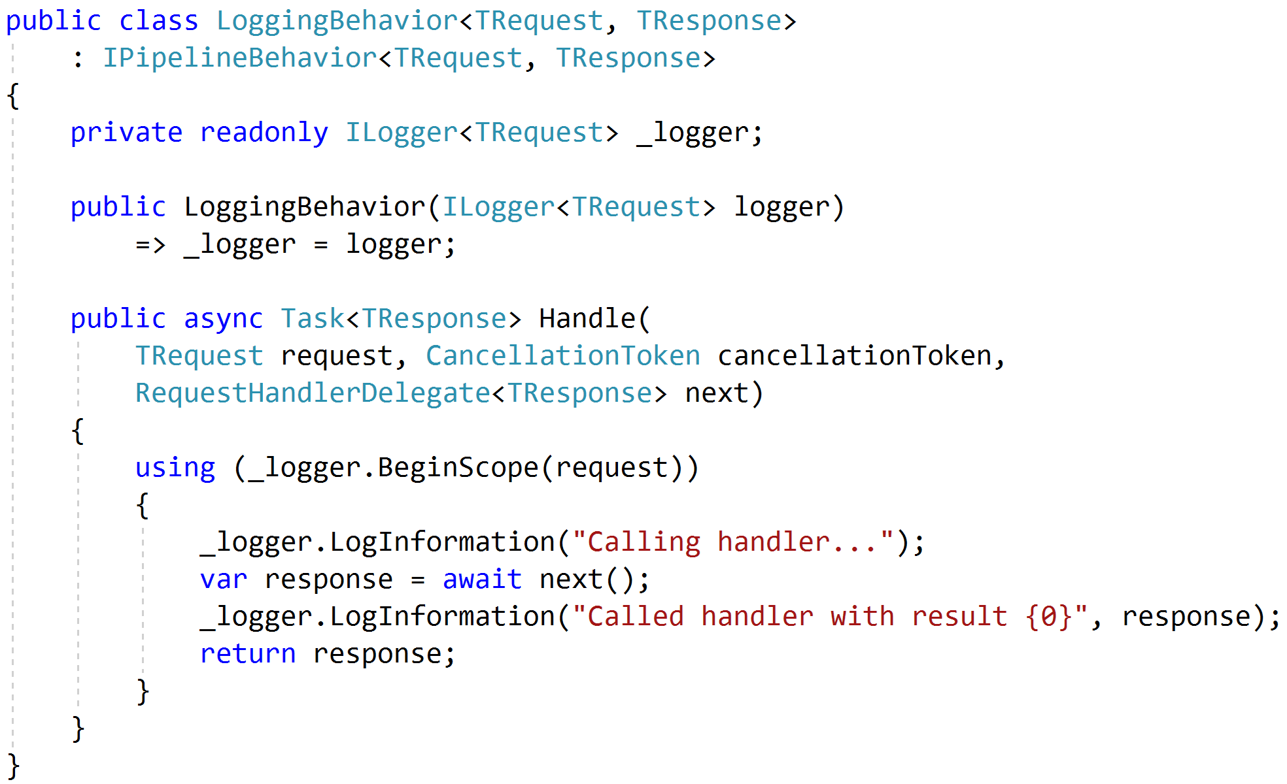
Logging

Slide 64
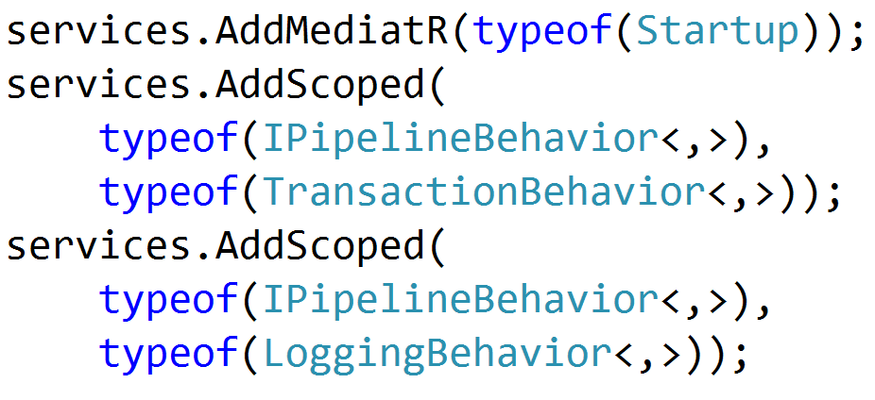

Registration

Slide 65
Testing
Pipeline Behavior
Pipeline Behavior
Pipeline Behavior
Request
Handler
Response
Arrange
Assert
Act

Slide 66
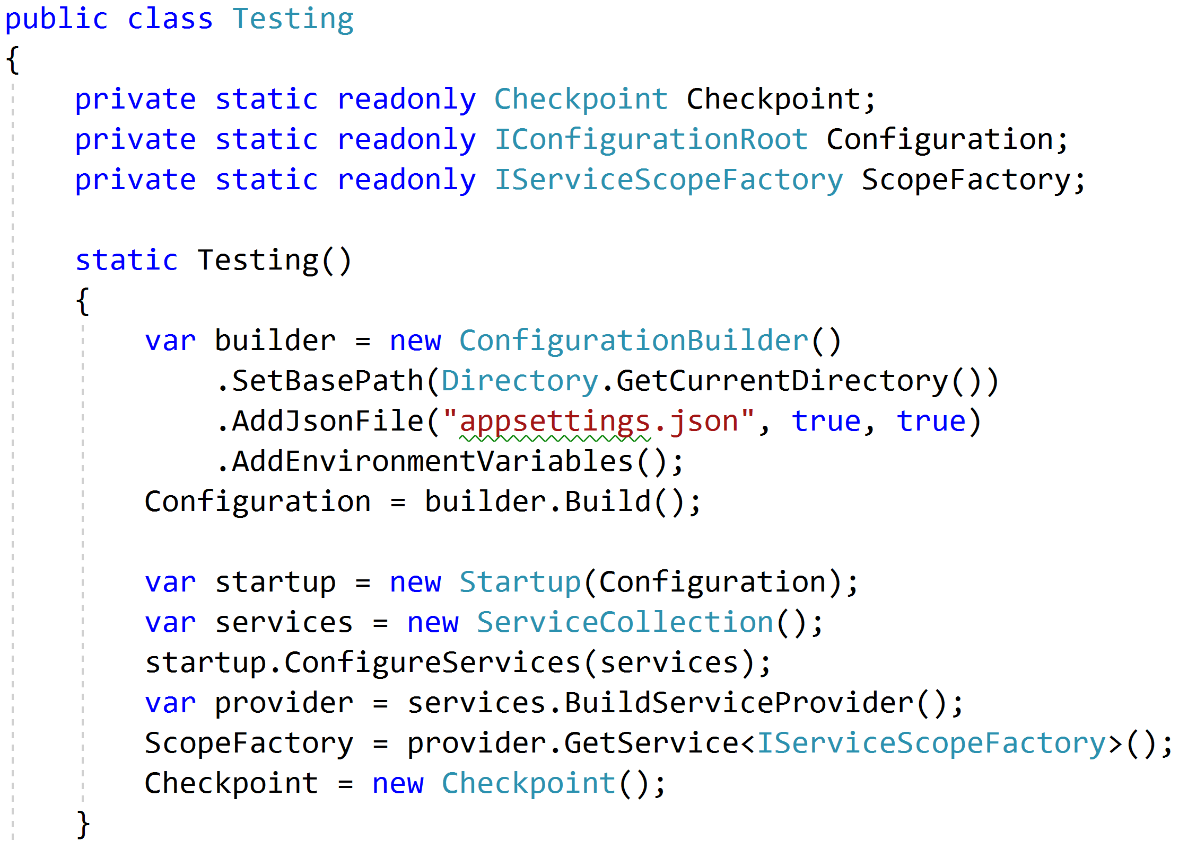
Reproduce Reality

Slide 67
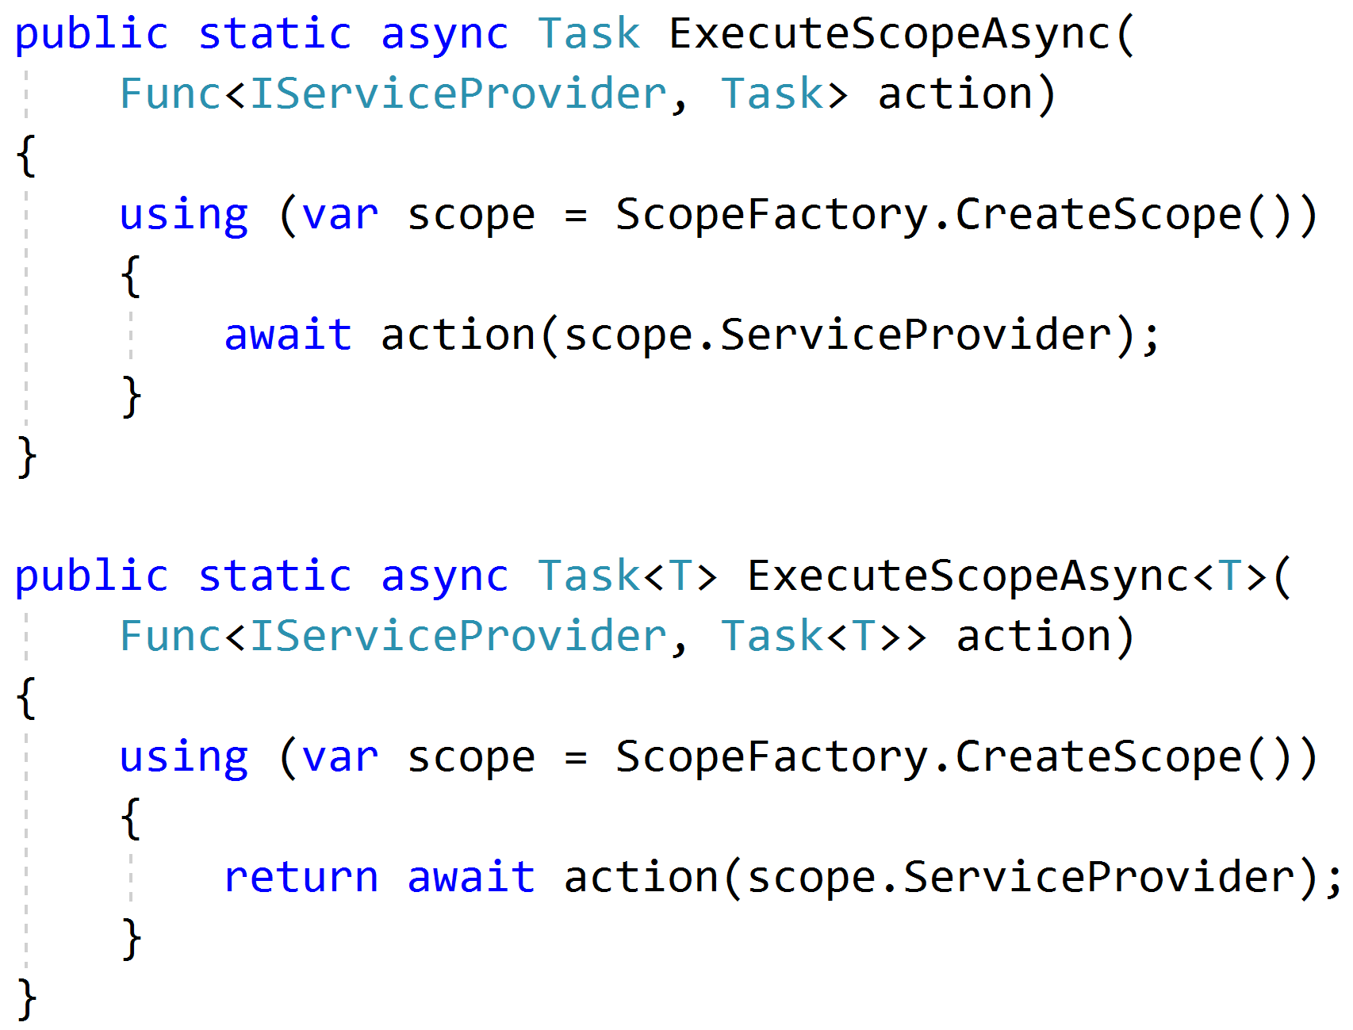
Mimicking Scoped Requests

Slide 68
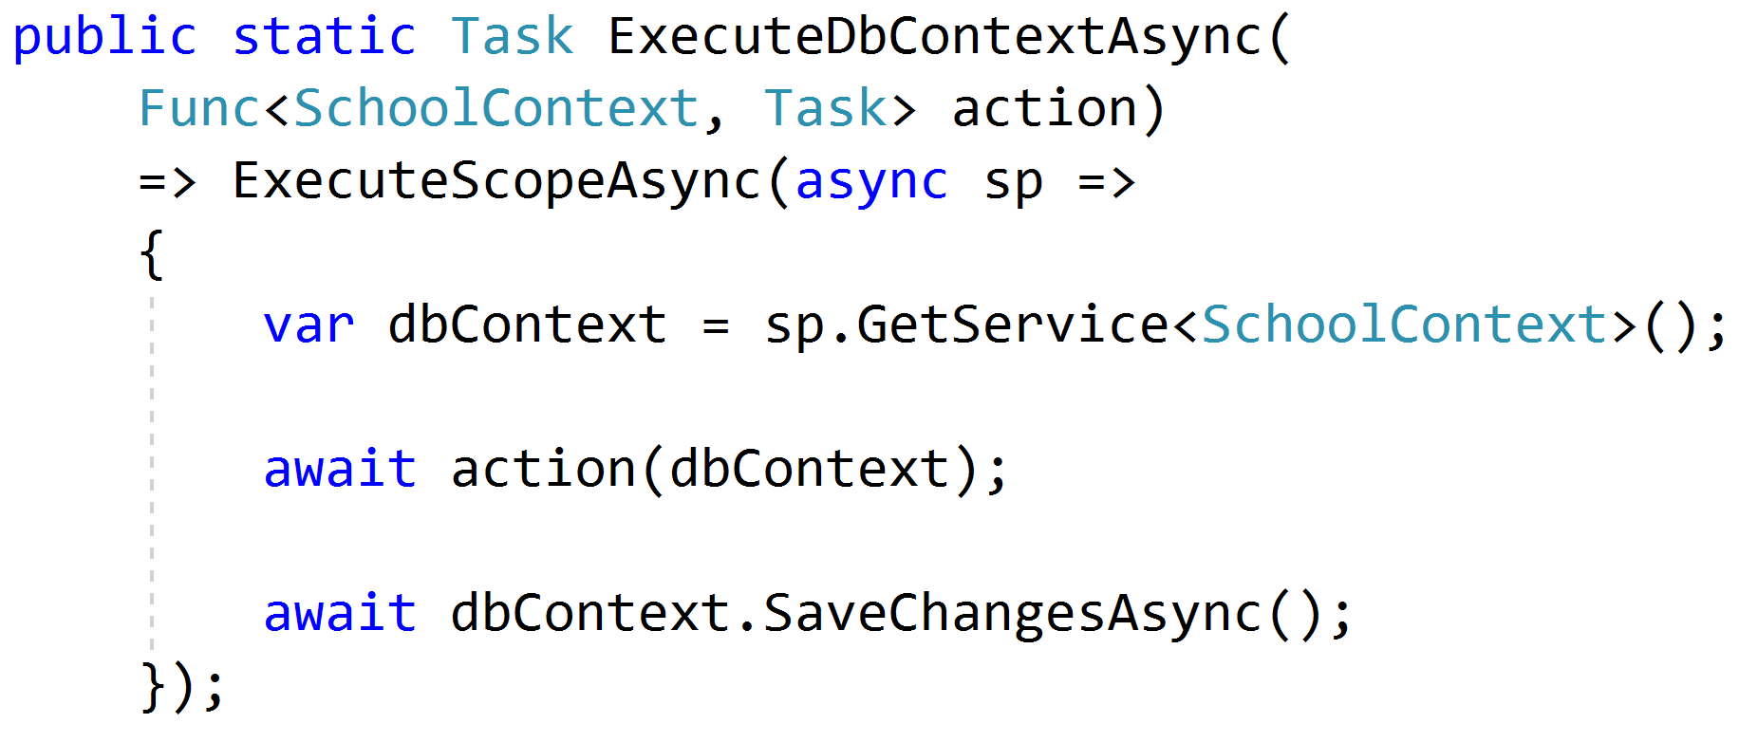
Setting Up Data

Slide 69
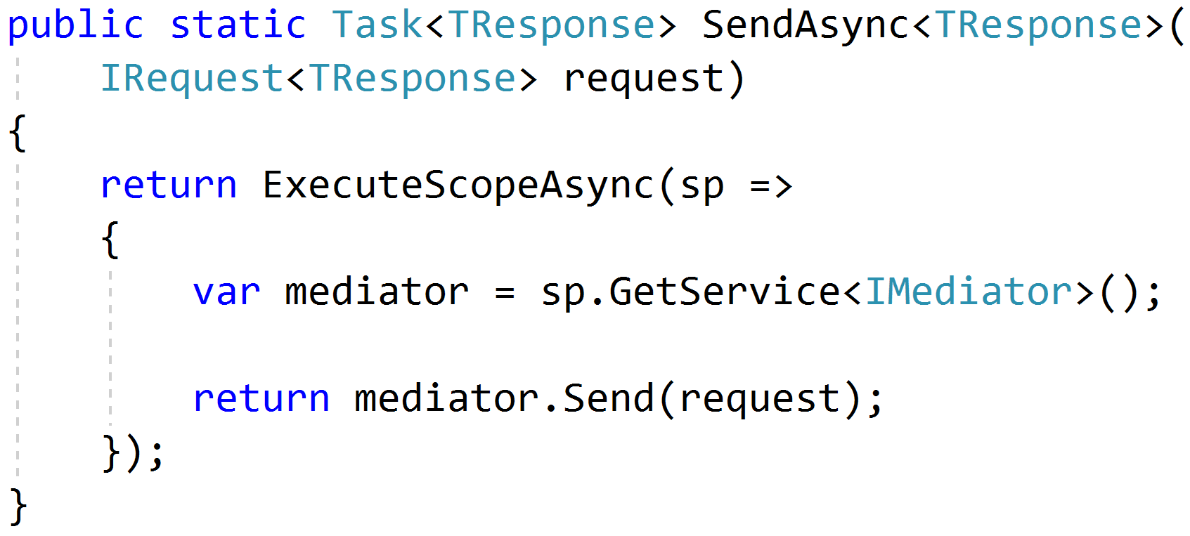
Sending Requests

Slide 70
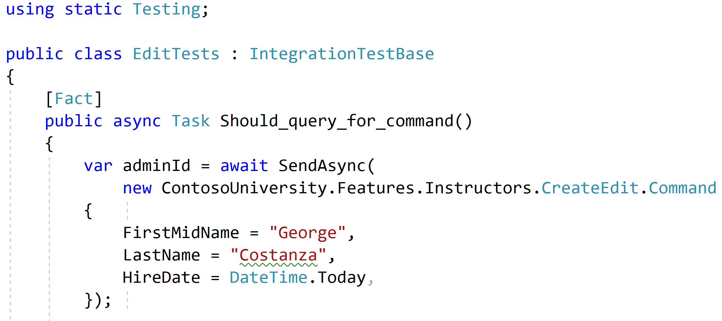
Using static helpers

Slide 71
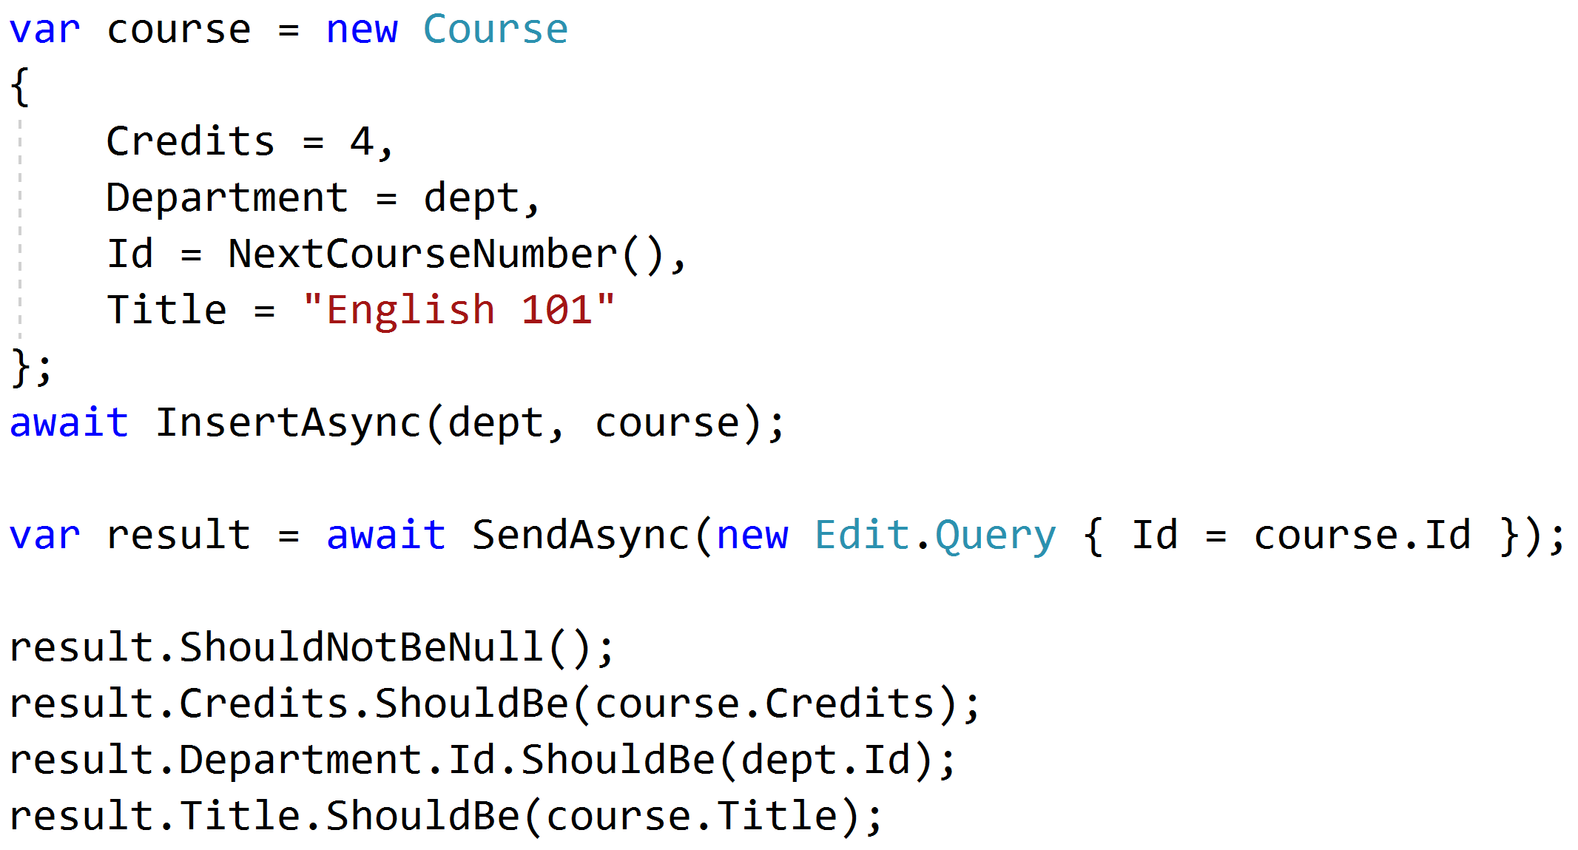
Testing queries through result

Slide 72
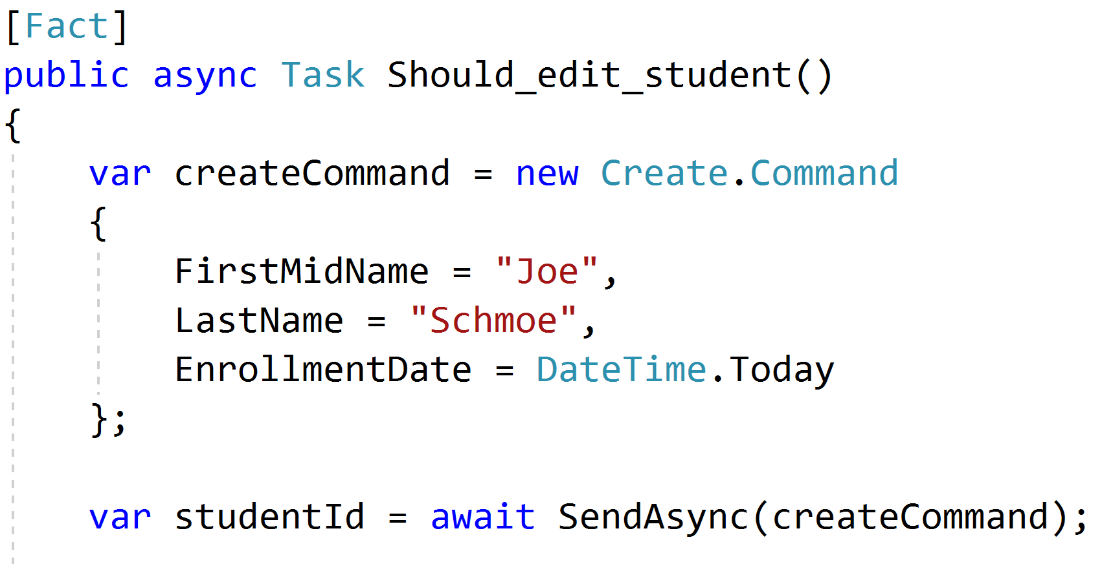
Setup through the front door

Slide 73
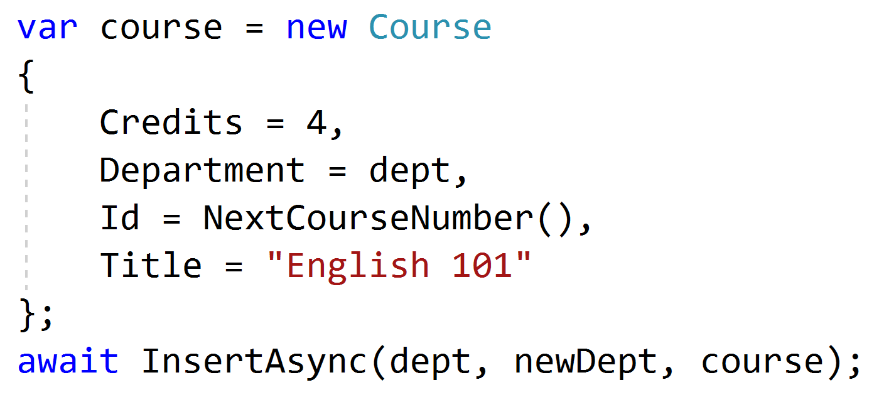
Setup data directly when needed

Slide 74
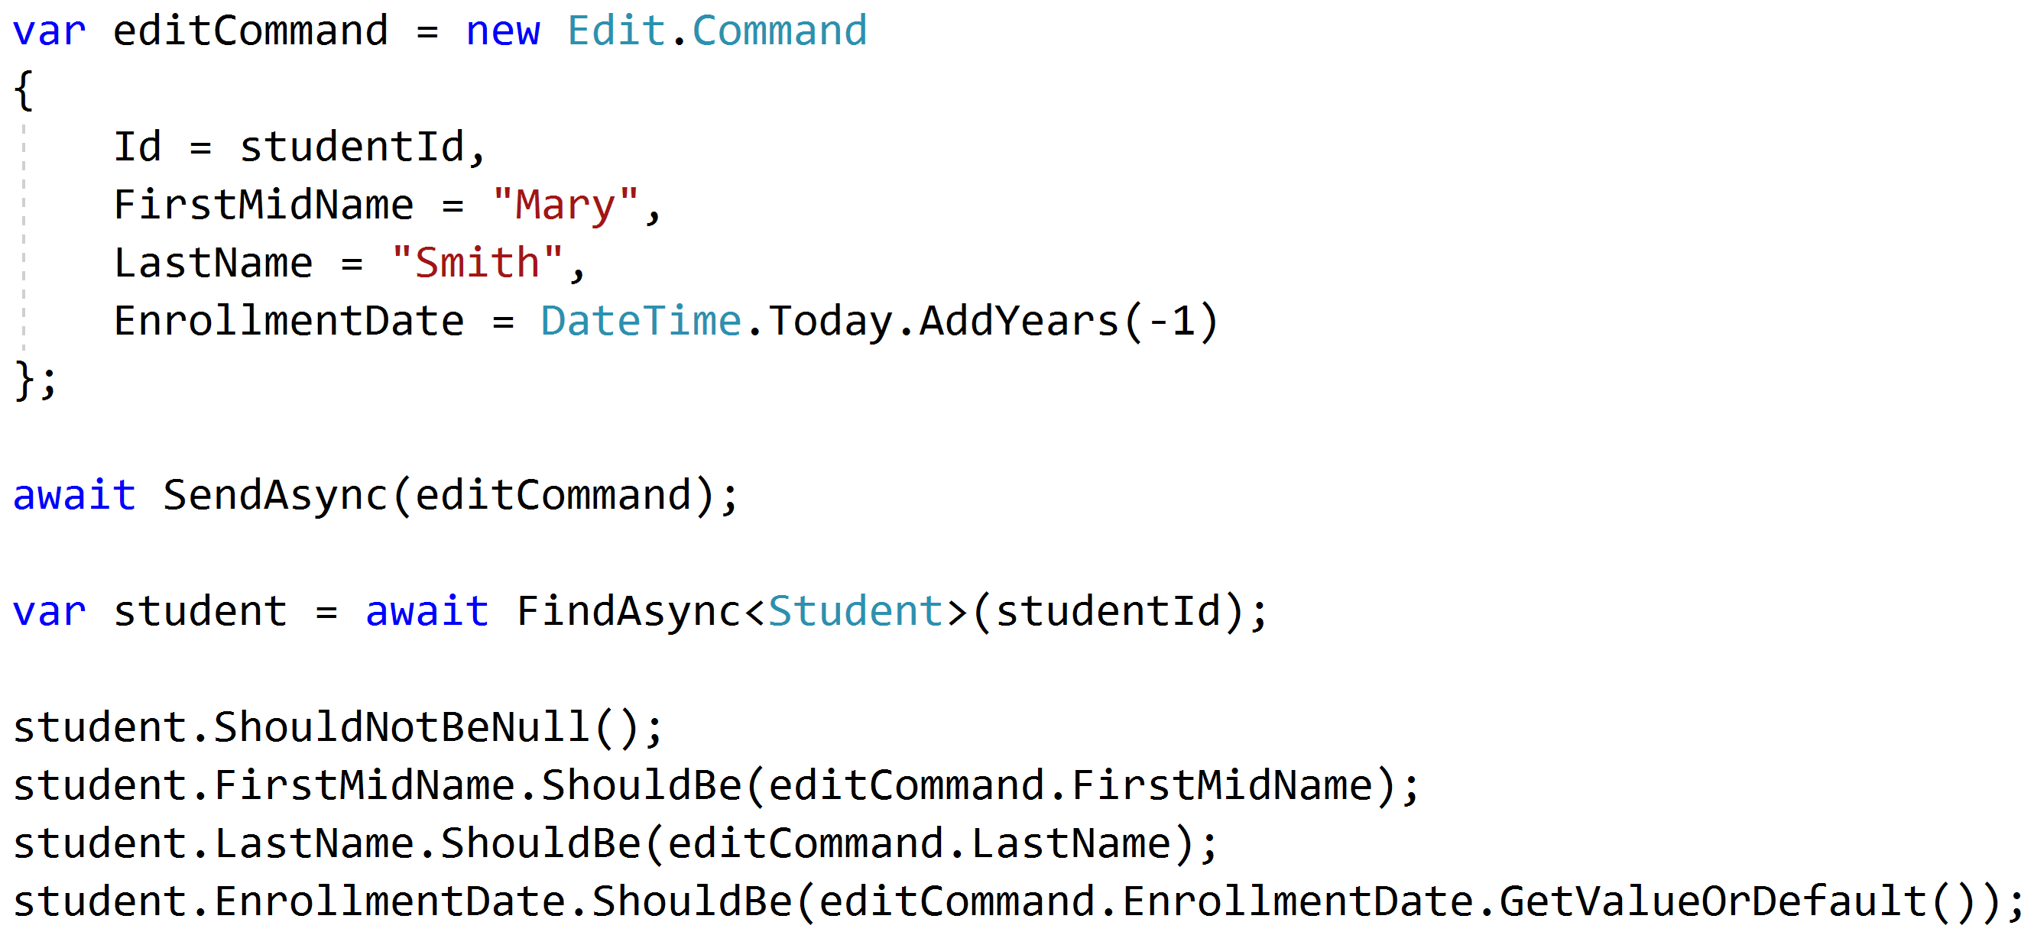
Test commands with roundtrips

Slide 75
Unit and Integration Tests
Pipeline Behavior
Integration Tests
Pipeline Behavior
Pipeline Behavior
Handler
Rich Domain Model
Unit Tests

Slide 76
Key Takeaways
Vertical slices makes code easy to add/change/delete
Do not skip refactor!
Push behavior down
Integration test handlers, unit test domain

Slide 77

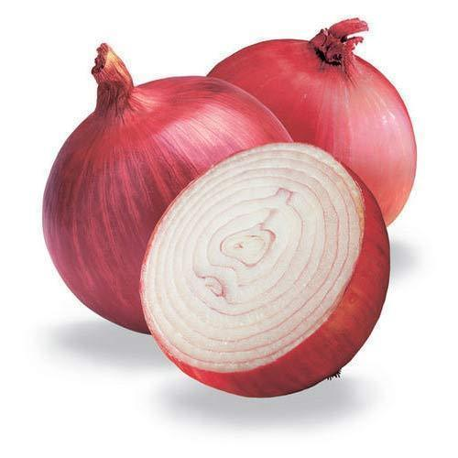
Vertical Slice Architecture
Jimmy Bogard
@jbogard
github.com/jbogard/presentations
jimmybogard.com

